Slide 1
Database Commands

Slide 2
SQL
SQL, or Structured Query Language, is a domain-specific language designed for managing and querying relational databases. It provides a standardized way to interact with databases, making it an essential tool for anyone working with data.
SQL commands are the fundamental building blocks for communicating with a database management system (DBMS).
These commands are used to perform various operations on a database, such as creating tables, inserting data, querying information, and controlling access and security. SQL commands can be categorized into different types, each serving a specific purpose in the database management process.

Slide 3
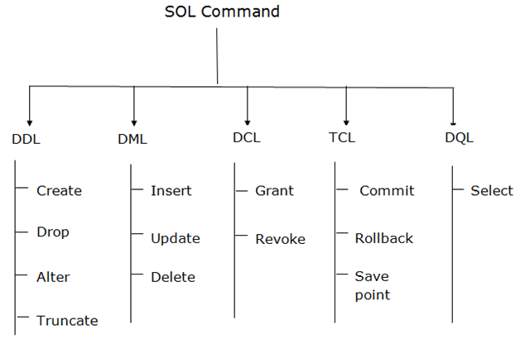
Types of SQL Commands
There are five types of SQL commands: DDL, DML, DCL, TCL, and DQL.

Slide 4
Data Definition Language (DDL)
Data Definition Language (DDL)
DDL changes the structure of the table like creating a table, deleting a table, altering a table, etc.
All the command of DDL are auto-committed that means it permanently save all the changes in the database.
Here are some commands that come under DDL:
CREATE
ALTER
DROP
TRUNCATE

Slide 5
CREATE It is used to create a new table in the database.
Syntax
CREATE TABLE TABLE_NAME (COLUMN_NAME DATATYPES[,....]);
Example:
CREATE TABLE EMPLOYEE(Name VARCHAR2(20), Email VARCHAR2(100), DOB DATE);

Slide 6
DROP: It is used to delete both the structure and record stored in the table.
Syntax
DROP TABLE table_name;
Example
DROP TABLE EMPLOYEE;

Slide 7
ALTER: It is used to alter the structure of the database. This change could be either to modify the characteristics of an existing attribute or probably to add a new attribute.
Syntax:
To add a new column in the table
ALTER TABLE table_name ADD column_name COLUMN-definition;
To modify existing column in the table:
ALTER TABLE table_name MODIFY(column_definitions....);
EXAMPLE
ALTER TABLE STU_DETAILS ADD(ADDRESS VARCHAR2(20));
ALTER TABLE STU_DETAILS MODIFY (NAME VARCHAR2(20));

Slide 8
TRUNCATE: It is used to delete all the rows from the table and free the space containing the table.
Syntax:
TRUNCATE TABLE table_name;
Example:
TRUNCATE TABLE EMPLOYEE;

Slide 9
Data Manipulation Language
DML commands are used to modify the database. It is responsible for all form of changes in the database.
The command of DML is not auto-committed that means it can't permanently save all the changes in the database. They can be rollback.
Here are some commands that come under DML:
INSERT
UPDATE
DELETE

Slide 10
INSERT: The INSERT statement is a SQL query. It is used to insert data into the row of a table.
Syntax:
INSERT INTO TABLE_NAME
(col1, col2, col3,.... col N)
VALUES (value1, value2, value3, .... valueN);

Slide 11
INSERT INTO TABLE_NAME
VALUES (value1, value2, value3, .... valueN);
For example:
INSERT INTO javatpoint (Author, Subject) VALUES ("Sonoo", "DBMS");

Slide 12
UPDATE: This command is used to update or modify the value of a column in the table.
Syntax:
UPDATE table_name SET [column_name1= value1,...column_nameN = valueN] [WHERE CONDITION]
For example:
UPDATE students
SET User_Name = 'Sonoo'
WHERE Student_Id = '3'

Slide 13
DELETE: It is used to remove one or more row from a table.
Syntax:
DELETE FROM table_name [WHERE condition];
For example:
DELETE FROM javatpoint
WHERE Author="Sonoo";

Slide 14
Data Control Language
DCL commands are used to grant and take back authority from any database user.
Here are some commands that come under DCL:
Grant
Revoke
a. Grant: It is used to give user access privileges to a database.
Example
GRANT SELECT, UPDATE ON MY_TABLE TO SOME_USER, ANOTHER_USER;

Slide 15
Revoke: It is used to take back permissions from the user.
Example
REVOKE SELECT, UPDATE ON MY_TABLE FROM USER1, USER2;

Slide 16
Transaction Control Language
TCL commands can only use with DML commands like INSERT, DELETE and UPDATE only.
These operations are automatically committed in the database that's why they cannot be used while creating tables or dropping them.
Here are some commands that come under TCL:
COMMIT
ROLLBACK
SAVEPOINT

Slide 17
Commit: Commit command is used to save all the transactions to the database.
Syntax:
COMMIT;
Example:
DELETE FROM CUSTOMERS
WHERE AGE = 25;
COMMIT;

Slide 18
Rollback: Rollback command is used to undo transactions that have not already been saved to the database.
Syntax:
ROLLBACK;
Example:
DELETE FROM CUSTOMERS
WHERE AGE = 25;
ROLLBACK;

Slide 19
SAVEPOINT: It is used to roll the transaction back to a certain point without rolling back the entire transaction.
Syntax:
SAVEPOINT SAVEPOINT_NAME;

Slide 20
Data Query Language(DQL)
DQL is used to fetch the data from the database.
It uses only one command:
SELECT
a. SELECT: This is the same as the projection operation of relational algebra. It is used to select the attribute based on the condition described by WHERE clause.
Syntax:
SELECT expressions
FROM TABLES
WHERE conditions;
For example:
SELECT emp_name
FROM employee
WHERE age > 20;

Slide 21
SQL Constraints
SQL constraints are used to specify rules for data in a table.
SQL Create Constraints
Constraints can be specified when the table is created with the CREATE TABLE statement, or after the table is created with the ALTER TABLE statement.
Syntax

Slide 22
CREATE TABLE table_name (
column1 datatype constraint,
column2 datatype constraint,
column3 datatype constraint,
....
);

Slide 23
SQL Constraints
SQL constraints are used to specify rules for the data in a table.
Constraints are used to limit the type of data that can go into a table. This ensures the accuracy and reliability of the data in the table. If there is any violation between the constraint and the data action, the action is aborted.
Constraints can be column level or table level. Column level constraints apply to a column, and table level constraints apply to the whole table.
The following constraints are commonly used in SQL:
NOT NULL - Ensures that a column cannot have a NULL value
UNIQUE - Ensures that all values in a column are different
PRIMARY KEY - A combination of a NOT NULL and UNIQUE. Uniquely identifies each row in a table
FOREIGN KEY - Prevents actions that would destroy links between tables
CHECK - Ensures that the values in a column satisfies a specific condition
DEFAULT - Sets a default value for a column if no value is specified
CREATE INDEX - Used to create and retrieve data from the database very quickly

Slide 24
SQL NOT NULL Constraint
By default, a column can hold NULL values.
The NOT NULL constraint enforces a column to NOT accept NULL values.
This enforces a field to always contain a value, which means that you cannot insert a new record, or update a record without adding a value to this field.
SQL NOT NULL on CREATE TABLE
The following SQL ensures that the "ID", "LastName", and "FirstName" columns will NOT accept NULL values when the "Persons" table is created:
CREATE TABLE Persons (
ID int NOT NULL,
LastName varchar(255) NOT NULL,
FirstName varchar(255) NOT NULL,
Age int
);

Slide 25
SQL UNIQUE Constraint
The UNIQUE constraint ensures that all values in a column are different.
Both the UNIQUE and PRIMARY KEY constraints provide a guarantee for uniqueness for a column or set of columns.
A PRIMARY KEY constraint automatically has a UNIQUE constraint.
However, you can have many UNIQUE constraints per table, but only one PRIMARY KEY constraint per table.
SQL UNIQUE Constraint on CREATE TABLE
The following SQL creates a UNIQUE constraint on the "ID" column when the "Persons" table is created:
CREATE TABLE Persons (
ID int UNIQUE,
LastName varchar(255) NOT NULL,
FirstName varchar(255),
Age int
);

Slide 26
SQL PRIMARY KEY Constraint
The PRIMARY KEY constraint uniquely identifies each record in a table.
Primary keys must contain UNIQUE values, and cannot contain NULL values.
A table can have only ONE primary key; and in the table, this primary key can consist of single or multiple columns (fields).
SQL PRIMARY KEY on CREATE TABLE
The following SQL creates a PRIMARY KEY on the "ID" column when the "Persons" table is created:
CREATE TABLE Persons1 (
ID int NOT NULL,
LastName varchar(255) NOT NULL,
FirstName varchar(255),
Age int,
PRIMARY KEY (ID)
);

Slide 27
insert into Persons1 values(123456,"Sugi","A",28);
Error: UNIQUE constraint failed: Persons1.ID
ID | LastName | FirstName | Age
123456 | Vidhya | A | 30

Slide 28
SQL FOREIGN KEY Constraint
The FOREIGN KEY constraint is used to prevent actions that would destroy links between tables.
A FOREIGN KEY is a field (or collection of fields) in one table, that refers to the PRIMARY KEY in another table.
The table with the foreign key is called the child table, and the table with the primary key is called the referenced or parent table.

Slide 29
Persons Table
PersonID | LastName | FirstName | Age
1 | Hansen | Ola | 30
2 | Svendson | Tove | 23
3 | Pettersen | Kari | 20

Slide 30
Orders Table
OrderID | OrderNumber | PersonID
1 | 77895 | 3
2 | 44678 | 3
3 | 22456 | 2
4 | 24562 | 1

Slide 31
Notice that the "PersonID" column in the "Orders" table points to the "PersonID" column in the "Persons" table.
The "PersonID" column in the "Persons" table is the PRIMARY KEY in the "Persons" table.
The "PersonID" column in the "Orders" table is a FOREIGN KEY in the "Orders" table.
The FOREIGN KEY constraint prevents invalid data from being inserted into the foreign key column, because it has to be one of the values contained in the parent table.

Slide 32
CREATE TABLE Orders12 (
orderid int NOT NULL,ID int, foreign key (ID)
references Persons2 (ID));

Slide 33
SQL CHECK Constraint
The CHECK constraint is used to limit the value range that can be placed in a column.
If you define a CHECK constraint on a column it will allow only certain values for this column.
If you define a CHECK constraint on a table it can limit the values in certain columns based on values in other columns in the row.
SQL CHECK on CREATE TABLE
The following SQL creates a CHECK constraint on the "Age" column when the "Persons" table is created. The CHECK constraint ensures that the age of a person must be 18, or older:
CREATE TABLE Persons3 (
ID int NOT NULL,
LastName varchar(255) NOT NULL,
FirstName varchar(255),
Age int,
CHECK (Age>=18)
);

Slide 34
ID | LastName | FirstName | Age
123 | A | Vidhya | 30
insert into persons3 values(123,"R","Akshat",10);
Error: CHECK constraint failed: Age>=18

Slide 35
The SQL ORDER BY
The ORDER BY keyword is used to sort the result-set in ascending or descending order.
select * from Customers order by first_name;
customer_id | first_name | last_name | age | country
1 | John | Doe | 31 | USA
2 | Robert | Luna | 22 | USA
3 | David | Robinson | 22 | UK
4 | John | Reinhardt | 25 | UK
5 | Betty | Doe | 28 | UAE

Slide 36
Output
select * from Customers order by first_name;
customer_id | first_name | last_name | age | country
5 | Betty | Doe | 28 | UAE
3 | David | Robinson | 22 | UK
1 | John | Doe | 31 | USA
4 | John | Reinhardt | 25 | UK
2 | Robert | Luna | 22 | USA

Slide 37
select * from Customers order by first_name desc;
customer_id | first_name | last_name | age | country
2 | Robert | Luna | 22 | USA
1 | John | Doe | 31 | USA
4 | John | Reinhardt | 25 | UK
3 | David | Robinson | 22 | UK
5 | Betty | Doe | 28 | UAE

Slide 38
The SQL AND Operator
The WHERE clause can contain one or many AND operators.
The AND operator is used to filter records based on more than one condition, like if you want to return all customers from USA that starts with the letter ‘D':
Example
Select all customers from USA that starts with the letter ‘D':
SELECT *
FROM Customers
WHERE Country = ‘USA' AND last_name LIKE ‘D%';

Slide 39
SELECT *
FROM Customers
WHERE country = 'USA' AND last_name LIKE 'D%';
customer_id | first_name | last_name | age | country
1 | John | Doe | 31 | USA
2 | Robert | Luna | 22 | USA
3 | David | Robinson | 22 | UK
4 | John | Reinhardt | 25 | UK
5 | Betty | Doe | 28 | UAE
customer_id | first_name | last_name | age | country
1 | John | Doe | 31 | USA

Slide 40
The SQL OR Operator
The WHERE clause can contain one or more OR operators.
The OR operator is used to filter records based on more than one condition, like if you want to return all customers from Germany but also those from Spain:
Example
Select all customers from UK or USA:
SELECT *
FROM Customers
WHERE country = 'USA' OR Country = 'UK';
Syntax
SELECT column1, column2, ...
FROM table_name
WHERE condition1 OR condition2 OR condition3 ...;

Slide 41
customer_id | first_name | last_name | age | country
1 | John | Doe | 31 | USA
2 | Robert | Luna | 22 | USA
3 | David | Robinson | 22 | UK
4 | John | Reinhardt | 25 | UK

Slide 42
The NOT Operator
The NOT operator is used in combination with other operators to give the opposite result, also called the negative result.
In the select statement below we want to return all customers that are NOT from Spain:
Example
Select only the customers that are NOT from UK:
SELECT * FROM Customers
WHERE NOT Country = ‘UK';
In the example above, the NOT operator is used in combination with the = operator, but it can be used in combination with other comparison and/or logical operators. See examples below.
Syntax
SELECT column1, column2, ...
FROM table_name
WHERE NOT condition;

Slide 43
customer_id | first_name | last_name | age | country
1 | John | Doe | 31 | USA
2 | Robert | Luna | 22 | USA
5 | Betty | Doe | 28 | UAE

Slide 44
SQL MIN() and MAX() Functions
The SQL MIN() and MAX() Functions
The MIN() function returns the smallest value of the selected column.
The MAX() function returns the largest value of the selected column.
MIN Example
Find the lowest price:
SELECT MIN(Price)
FROM Products;
MAX Example
Find the highest price:
SELECT MAX(Price)
FROM Products;

Slide 45
order_id | item | amount | customer_id
1 | Keyboard | 400 | 4
2 | Mouse | 300 | 4
3 | Monitor | 12000 | 3
4 | Keyboard | 400 | 1
5 | Mousepad | 250 | 2
SELECT MIN(amount)
FROM Orders;
SELECT MAX(amount)
FROM Orders;
min(amount)
250
max(amount)
12000

Slide 46
The SQL COUNT() Function
The COUNT() function returns the number of rows that matches a specified criterion.
Example
Find the total number of orders in the Orders table:
SELECT COUNT(*)
FROM Orders;
select count(*) from orders;
count(*)
5

Slide 47
The SQL SUM() Function
The SUM() function returns the total sum of a numeric column.
Example
Return the sum of all Quantity fields in the OrderDetails table:
SELECT SUM(Quantity)
FROM OrderDetails;

Slide 48
SELECT SUM(amount)
FROM Orders;
SUM(amount)
13350

Slide 49
The SQL AVG() Function
The AVG() function returns the average value of a numeric column.
Example
Find the average price of all products:
SELECT AVG(amount)
FROM Orders;
AVG(amount)
2670

Slide 50
The SQL LIKE Operator
The LIKE operator is used in a WHERE clause to search for a specified pattern in a column.
There are two wildcards often used in conjunction with the LIKE operator:
The percent sign % represents zero, one, or multiple characters
The underscore sign _ represents one, single character

Slide 51
SELECT *
FROM Customers
WHERE last_name LIKE 'D%’;
customer_id | first_name | last_name | age | country
1 | John | Doe | 31 | USA
5 | Betty | Doe | 28 | UAE

Slide 52
SELECT *
FROM Orders
WHERE item LIKE '%d';
order_id | item | amount | customer_id
1 | Keyboard | 400 | 4
4 | Keyboard | 400 | 1
5 | Mousepad | 250 | 2

Slide 53
Contains
To return records that contains a specific letter or phrase, add the % both before and after the letter or phrase.
SELECT *
FROM Orders
WHERE item LIKE '%o%';

Slide 54
order_id | item | amount | customer_id
1 | Keyboard | 400 | 4
2 | Mouse | 300 | 4
3 | Monitor | 12000 | 3
4 | Keyboard | 400 | 1
5 | Mousepad | 250 | 2

Slide 55
SELECT *
FROM Orders
WHERE item LIKE ‘_o___';
order_id | item | amount | customer_id
2 | Mouse | 300 | 4

Slide 56
The SQL IN Operator
The IN operator allows you to specify multiple values in a WHERE clause.
The IN operator is a shorthand for multiple OR conditions.
Example
Return all customers from ‘USA', or 'UK'

Slide 57
SELECT * FROM Customers
WHERE Country IN ('UK’,’USA’);
customer_id | first_name | last_name | age | country
1 | John | Doe | 31 | USA
2 | Robert | Luna | 22 | USA
3 | David | Robinson | 22 | UK
4 | John | Reinhardt | 25 | UK

Slide 58
The SQL BETWEEN Operator
The BETWEEN operator selects values within a given range. The values can be numbers, text, or dates.
The BETWEEN operator is inclusive: begin and end values are included.
Example
SELECT * FROM Orders
where amount between 300 and 1000;

Slide 59
order_id | item | amount | customer_id
1 | Keyboard | 400 | 4
2 | Mouse | 300 | 4
4 | Keyboard | 400 | 1

Slide 60
SQL JOIN
The SQL JOIN statement is used to combine rows from two tables based on a common column and selects records that have matching values in these columns.
SQL JOIN Syntax
SELECT columns_from_both_tables
FROM table1
JOIN table2
ON table1.column1 = table2.column2
Here,
table1 and table2 are the two tables that are to be joined
column1 is the column in table1 that is related to column2 in table2

Slide 61
Example
-- join the Customers and Orders tables
-- based on the common values of their customer_id columns
SELECT Customers.customer_id, Customers.first_name, Orders.item
FROM Customers
JOIN Orders
ON Customers.customer_id = Orders.customer_id;
Run Code
Here, the SQL command joins the Customers and Orders tables based on the common column, customer_id of both tables.

Slide 62
customer_id | first_name | item
4 | John | Keyboard
4 | John | Mouse
3 | David | Monitor
1 | John | Keyboard
2 | Robert | Mousepad
The result set will consist of
customer_id and first_name columns from the Customers table
item column from the Orders table

Slide 63
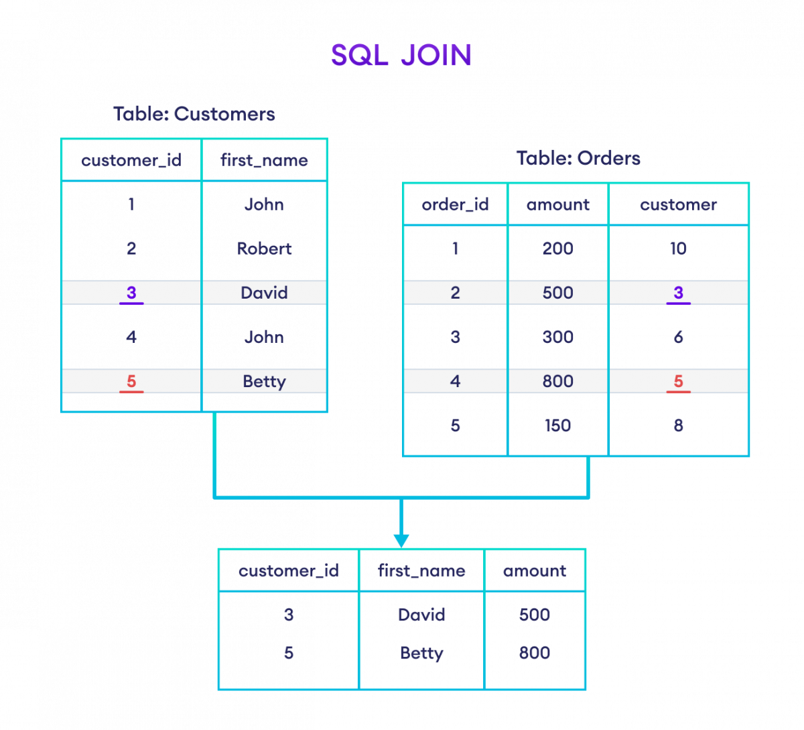

Slide 64
Types of SQL JOINs
In SQL, we have four main types of joins:
INNER JOIN
LEFT JOIN
RIGHT JOIN
FULL OUTER JOIN

Slide 65
SQL INNER JOIN
The SQL INNER JOIN statement joins two tables based on a common column and selects rows that have matching values in these columns.
SQL INNER JOIN Syntax
SELECT columns_from_both_tables
FROM table1
INNER JOIN table2
ON table1.column1 = table2.column2
Here,
table1 and table2 - two tables that are to be joined
column1 and column2 - columns common to in table1 and table2

Slide 66
Example
-- join Customers and Orders tables with their matching fields customer_id
SELECT Customers.customer_id, Orders.item
FROM Customers
INNER JOIN Orders
ON Customers.customer_id = Orders.customer_id;
Here, the SQL command joins the Customers and Orders tables.
The result includes customer_id (from Customers) and item (from Orders) of rows where customer IDs match (Customer.customer_id = Orders.customer_id).

Slide 67
customer_id | item
4 | Keyboard
4 | Mouse
3 | Monitor
1 | Keyboard
2 | Mousepad

Slide 68
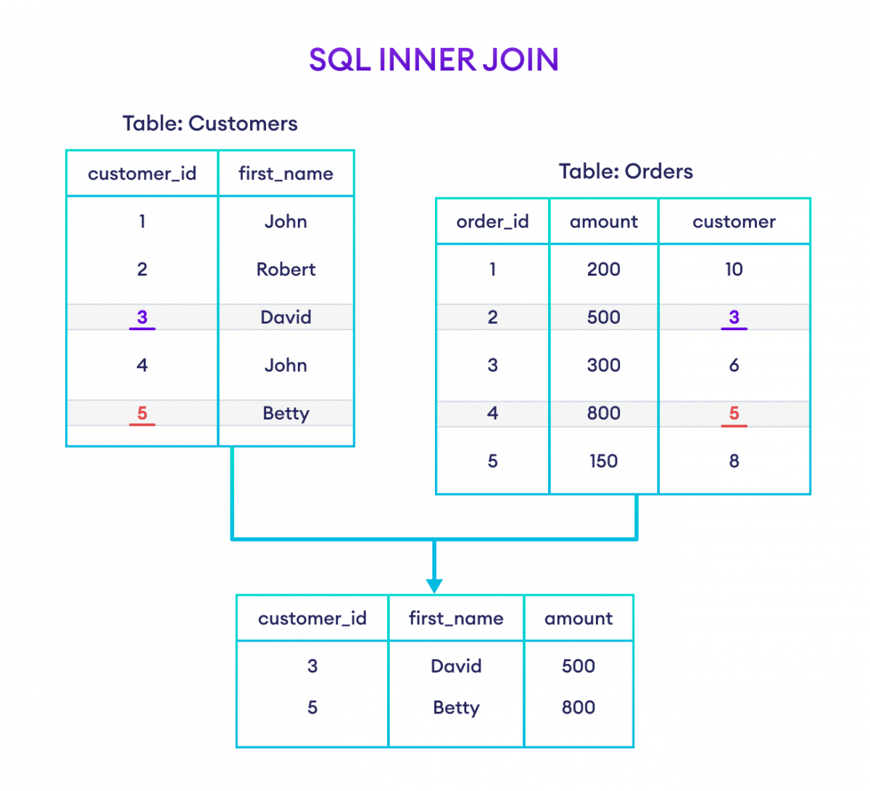

Slide 69
SQL LEFT JOIN
The SQL LEFT JOIN combines two tables based on a common column. It then selects records having matching values in these columns and the remaining rows from the left table.
SQL LEFT JOIN Syntax
SELECT columns_from_both_tables
FROM table1
LEFT JOIN table2
ON table1.column1 = table2.column2
Here,
table1 is the left table to be joined
table2 is the right table to be joined
column1 and column2 are the common columns in the two tables

Slide 70
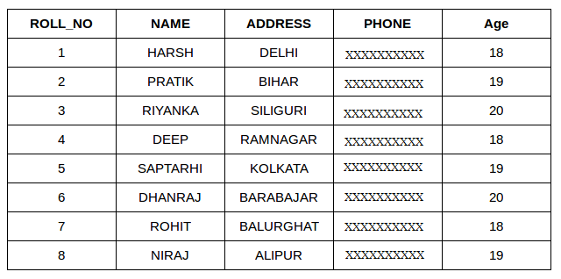
Student

Slide 71
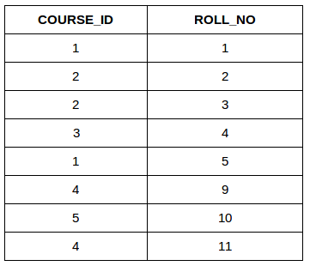
StudentCourse

Slide 72
INNER JOIN
The INNER JOIN keyword selects all rows from both the tables as long as the condition is satisfied. This keyword will create the result-set by combining all rows from both the tables where the condition satisfies i.e value of the common field will be the same.
Syntax:
SELECT table1.column1,table1.column2,table2.column1,....
FROM table1
INNER JOIN table2
ON table1.matching_column = table2.matching_column;
table1: First table.
table2: Second table
matching_column: Column common to both the tables.

Slide 73
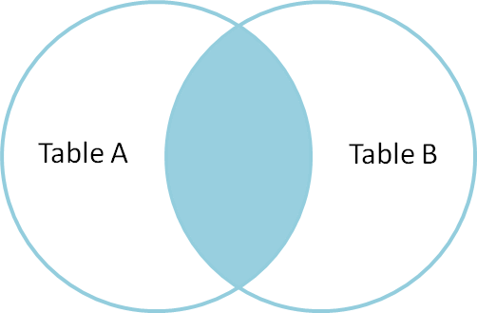

Slide 74
Example Queries(INNER JOIN)
SELECT StudentCourse.COURSE_ID, Student.NAME, Student.AGE FROM Student
INNER JOIN StudentCourse
ON Student.ROLL_NO = StudentCourse.ROLL_NO;

Slide 75
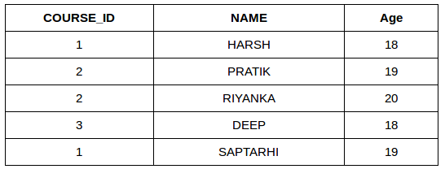

Slide 76
LEFT JOIN
This join returns all the rows of the table on the left side of the join and matches rows for the table on the right side of the join. For the rows for which there is no matching row on the right side, the result-set will contain null. LEFT JOIN is also known as LEFT OUTER JOIN.
Syntax:
SELECT table1.column1,table1.column2,table2.column1,....
FROM table1
LEFT JOIN table2
ON table1.matching_column = table2.matching_column;
table1: First table.
table2: Second table
matching_column: Column common to both the tables.

Slide 77
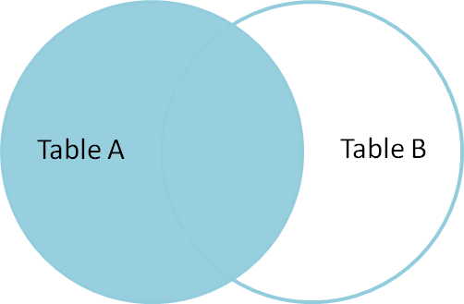

Slide 78
SELECT Student.NAME,StudentCourse.COURSE_ID
FROM Student
LEFT JOIN StudentCourse
ON StudentCourse.ROLL_NO = Student.ROLL_NO;

Slide 79
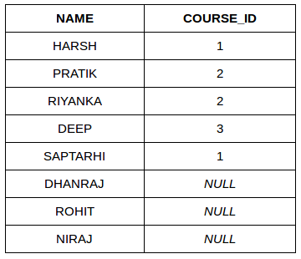

Slide 80
RIGHT JOIN
RIGHT JOIN is similar to LEFT JOIN. This join returns all the rows of the table on the right side of the join and matching rows for the table on the left side of the join. For the rows for which there is no matching row on the left side, the result-set will contain null. RIGHT JOIN is also known as RIGHT OUTER JOIN.
Syntax:
SELECT table1.column1,table1.column2,table2.column1,....
FROM table1
RIGHT JOIN table2
ON table1.matching_column = table2.matching_column;
table1: First table.
table2: Second table
matching_column: Column common to both the tables.

Slide 81
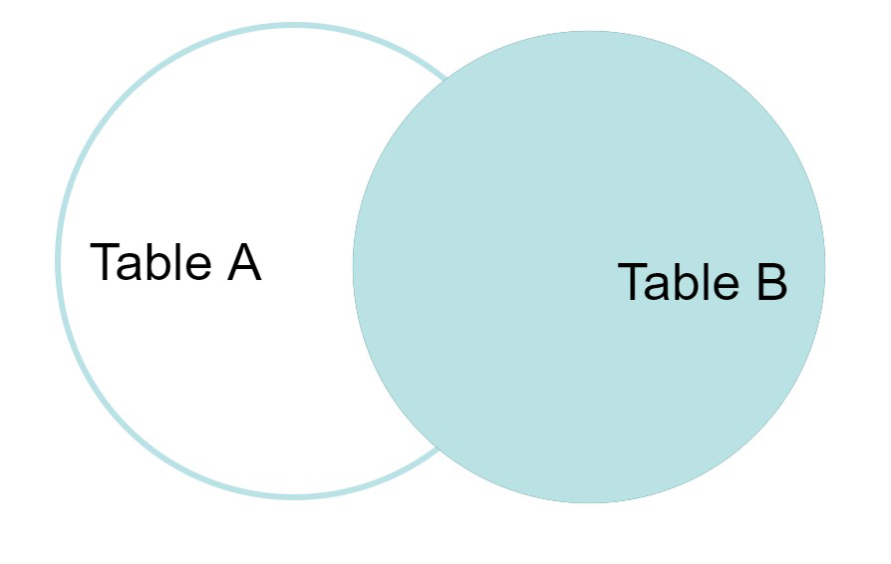

Slide 82
Example Queries(RIGHT JOIN):
SELECT Student.NAME,StudentCourse.COURSE_ID
FROM Student
RIGHT JOIN StudentCourse
ON StudentCourse.ROLL_NO = Student.ROLL_NO;

Slide 83
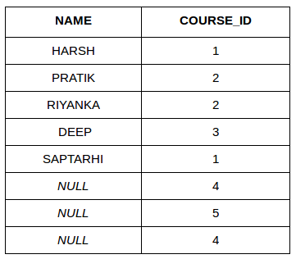

Slide 84
FULL JOIN
FULL JOIN creates the result-set by combining results of both LEFT JOIN and RIGHT JOIN.
The result-set will contain all the rows from both tables. For the rows for which there is no matching, the result-set will contain NULL values.

Slide 85
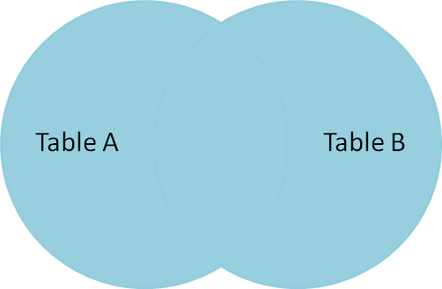

Slide 86
Syntax:
SELECT table1.column1,table1.column2,table2.column1,....
FROM table1
FULL JOIN table2
ON table1.matching_column = table2.matching_column;
table1: First table.
table2: Second table
matching_column: Column common to both the tables.
Example Queries(FULL JOIN):
SELECT Student.NAME,StudentCourse.COURSE_ID
FROM Student
FULL JOIN StudentCourse
ON StudentCourse.ROLL_NO = Student.ROLL_NO;

Slide 87
NAME | COURSE_ID
HARSH | 1
PRATIK | 2
RIYANKA | 2
DEEP | 3
SAPTARHI | 1
DHANRAJ | NULL
ROHIT | NULL
NIRAJ | NULL
NULL | 4
NULL | 5
NULL | 4

Slide 88
Mathematical Functions
Mathematical functions are present in SQL which can be used to perform mathematical calculations. Some commonly used mathematical functions are given below:
ABS(): Returns the absolute value of a number.
ROUND(): Rounds a number to a specified number of decimal places.
POWER(): Raises a number to a specified power.
SQRT(): Calculates the square root of a number.

Slide 89
Mathematical Functions
select abs(-100);
abs(-100)
100
select round(100.5);
101
select round(100.4);
100

Slide 90
select ceil(100.4);
101
select floor(100.7);
100
Select SQRT(25);
5
Select power(2,3);
8

Slide 91
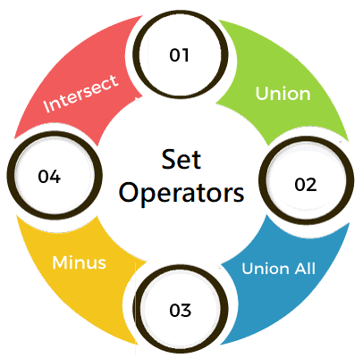
SET Operators in SQL
SET operators are special type of operators which are used to combine the result of two queries.
Operators covered under SET operators are:
UNION
UNION ALL
INTERSECT
MINUS

Slide 92
Rules for SET operation
There are certain rules which must be followed to perform operations using SET operators in SQL. Rules are as follows:
The number and order of columns must be the same.
Data types must be compatible.

Slide 93
Table 1: t_employees
ID | Name | Department | Salary | Year_of_Experience
1 | Aakash Singh | Development | 72000 | 2
2 | Abhishek Pawar | Production | 45000 | 1
3 | Pranav Deshmukh | HR | 59900 | 3
4 | Shubham Mahale | Accounts | 57000 | 2
5 | Sunil Kulkarni | Development | 87000 | 3
6 | Bhushan Wagh | R&D | 75000 | 2
7 | Paras Jaiswal | Marketing | 32000 | 1

Slide 94
Table 2: t2_employees
ID | Name | Department | Salary | Year_of_Experience
1 | Prashant Wagh | R&D | 49000 | 1
2 | Abhishek Pawar | Production | 45000 | 1
3 | Gautam Jain | Development | 56000 | 4
4 | Shubham Mahale | Accounts | 57000 | 2
5 | Rahul Thakur | Production | 76000 | 4
6 | Bhushan Wagh | R&D | 75000 | 2
7 | Anand Singh | Marketing | 28000 | 1

Slide 95
UNION
UNION will be used to combine the result of two select statements.
Duplicate rows will be eliminated from the results obtained after performing the UNION operation.
Example 1:
Write a query to perform union between the table t_employees and the table t2_employees.
SELECT *FROM t_employees UNION SELECT *FROM t2_employees;
Here, in a single query, we have written two SELECT queries. The first SELECT query will fetch the records from the t_employees table and perform a UNION operation with the records fetched by the second SELECT query from the t2_employees table.

Slide 96
ID | Name | Department | Salary | Year_of_Experience
1 | Soniya Jain | Udaipur | 89 | Physics
2 | Harshada Sharma | Kanpur | 92 | Chemistry
3 | Anuja Rajput | Jaipur | 78 | History
4 | Pranali Singh | Nashik | 88 | Geography
5 | Renuka Deshmukh | Panipat | 90 | Biology
6 | Swati Kumari | Faridabad | 93 | English
7 | Prachi Jaiswal | Gurugram | 96 | Hindi
2 | Ishwari Dixit | Delhi | 86 | Hindi
4 | Pakhi Arora | Surat | 70 | Sanskrit
6 | Jayshree Patel | Pune | 91 | Maths

Slide 97
UNION ALL
This operator combines all the records from both the queries.
Duplicate rows will be not be eliminated from the results obtained after performing the UNION ALL operation.
Example 1:
Write a query to perform union all operation between the table t_employees and the table t2_employees.
mysql> SELECT *FROM t_employees UNION ALL SELECT *FROM t2_employees;
Here, in a single query, we have written two SELECT queries. The first SELECT query will fetch the records from the t_employees table and perform UNION ALL operation with the records fetched by the second SELECT query from the t2_employees table.

Slide 98
ID | Name | Department | Salary | Year_of_Experience
1 | Aakash Singh | Development | 72000 | 2
2 | Abhishek Pawar | Production | 45000 | 1
3 | Pranav Deshmukh | HR | 59900 | 3
4 | Shubham Mahale | Accounts | 57000 | 2
5 | Sunil Kulkarni | Development | 87000 | 3
6 | Bhushan Wagh | R&D | 75000 | 2
7 | Paras Jaiswal | Marketing | 32000 | 1
1 | Prashant Wagh | R&D | 49000 | 1
2 | Abhishek Pawar | Production | 45000 | 1
3 | Gautam Jain | Development | 56000 | 4
4 | Shubham Mahale | Accounts | 57000 | 2
5 | Rahul Thakur | Production | 76000 | 4
6 | Bhushan Wagh | R&D | 75000 | 2
7 | Anand Singh | Marketing | 28000 | 1

Slide 99
INTERSECT
It is used to combine two SELECT statements, but it only returns the records which are common from both SELECT statements.
Example 1:
Write a query to perform intersect operation between the table t_employees and the table t2_employees.
SELECT *FROM t_employees INTERSECT SELECT *FROM t2_employees;
Here, in a single query, we have written two SELECT queries. The first SELECT query will fetch the records from the t_employees table and perform INTERSECT operation with the records fetched by the second SELECT query from the t2_employees table.

Slide 100
ID | Name | Hometown | Percentage | Favourite_Subject
2 | Abhishek Pawar | Production | 45000 | 1
4 | Shubham Mahale | Accounts | 57000 | 2
6 | Bhushan Wagh | R&D | 75000 | 2

Slide 101
MINUS
It displays the rows which are present in the first query but absent in the second query with no duplicates.
Example 1:
Write a query to perform a minus operation between the table t_employees and the table t2_employees.
Query:
SELECT *FROM t_employees MINUS SELECT *FROM t2_employees;
Here, in a single query, we have written two SELECT queries. The first SELECT query will fetch the records from the t_employees table and perform MINUS operation with the records fetched by the second SELECT query from the t2_employees table.

Slide 102
ID | Name | Department | Salary | Year_of_Experience
1 | Aakash Singh | Development | 72000 | 2
3 | Pranav Deshmukh | HR | 59900 | 3
5 | Sunil Kulkarni | Development | 87000 | 3
7 | Paras Jaiswal | Marketing | 32000 | 1

Slide 103
The SQL GROUP BY Statement
The GROUP BY statement groups rows that have the same values into summary rows, like "find the number of customers in each country".
The GROUP BY statement is often used with aggregate functions (COUNT(), MAX(), MIN(), SUM(), AVG()) to group the result-set by one or more columns.
GROUP BY Syntax
SELECT column_name(s)
FROM table_name
WHERE condition
GROUP BY column_name(s)
ORDER BY column_name(s);

Slide 104
SELECT COUNT(Customer_id), Country
FROM Customers
GROUP BY Country;
COUNT(Customer_id) | country
1 | UAE
2 | UK
2 | USA

Slide 105
The SQL HAVING Clause
The HAVING clause was added to SQL because the WHERE keyword cannot be used with aggregate functions.
HAVING Syntax
SELECT column_name(s)
FROM table_name
WHERE condition
GROUP BY column_name(s)
HAVING condition
ORDER BY column_name(s);

Slide 106
SELECT COUNT(Customer_id), Country
FROM Customers
GROUP BY Country
having count(customer_id)>1;
COUNT(Customer_id) | country
2 | UK
2 | USA

Slide 107
SQL Subquery
The Subquery or Inner query is an SQL query placed inside another SQL query. It is embedded in the HAVING or WHERE clause of the SQL statements.
Following are the important rules which must be followed by the SQL Subquery:
The SQL subqueries can be used with the following statements along with the SQL expression operators:
SELECT statement,
UPDATE statement,
INSERT statement, and
DELETE statement.

Slide 108
The subqueries in SQL are always enclosed in the parenthesis and placed on the right side of the SQL operators.
We cannot use the ORDER BY clause in the subquery. But, we can use the GROUP BY clause, which performs the same function as the ORDER BY clause.
If the subquery returns more than one record, we have to use the multiple value operators before the Subquery.
We can use the BETWEEN operator within the subquery but not with the subquery.

Slide 109
Subquery with SELECT statement
In SQL, inner queries or nested queries are used most frequently with the SELECT statement. The syntax of Subquery with the SELECT statement is described in the following block:
SELECT Column_Name1, Column_Name2, ...., Column_NameN
FROM Table_Name WHERE Column_Name Comparison_Operator
( SELECT Column_Name1, Column_Name2, ...., Column_NameN
FROM Table_Name WHERE condition);

Slide 110
SELECT * FROM Orders
WHERE amount> ( SELECT AVG(amount ) from orders);
order_id | item | amount | customer_id
3 | Monitor | 12000 | 3
AVG(amount )
2670

Slide 111
SELECT * FROM Orders WHERE customer_id IN (
SELECT customer_id FROM Customers WHERE country = 'UK' ) ;
order_id | item | amount | customer_id
1 | Keyboard | 400 | 4
2 | Mouse | 300 | 4
3 | Monitor | 12000 | 3

Slide 112
Subquery with the INSERT statement
We can also use the subqueries and nested queries with the INSERT statement in Structured Query Language.
We can insert the results of the subquery into the table of the outer query. The syntax of Subquery with the INSERT statement is described in the following block:
INSERT INTO Table_Name SELECT * FROM Table_Name WHERE Column_Name Operator (Subquery);
Examples of Subquery with the INSERT Statement

Slide 113
insert into person1 select * from person;
select * from person1;
id | name | age
123 | Akshat | 15
124 | Akshera | 15

Slide 114
Subquery with the UPDATE statement
The subqueries and nested queries can be used with the UPDATE statement in Structured Query Language for updating the columns of the existing table. We can easily update one or more columns using a subquery with the UPDATE statement.
Syntax of Subquery with the UPDATE statement
UPDATE Table_Name SET Column_Name = New_value WHERE Value OPERATOR (SELECT COLUMN_NAME FROM TABLE_NAME WHERE Condition) ;
Example of Subquery with the UPDATE statement
This example updates the record of one table using the IN operator with Subquery in the UPDATE statement.

Slide 115
UPDATE Orders SET amount = amount + 500 WHERE customer_id IN ( SELECT customer_id FROM Customers WHERE country = 'USA' ) ;
order_id | item | amount | customer_id
1 | Keyboard | 2400 | 4
2 | Mouse | 2300 | 4
3 | Monitor | 14000 | 3
4 | Keyboard | 1900 | 1
5 | Mousepad | 1750 | 2

Slide 116
Subquery with the DELETE statement
We can easily delete one or more records from the SQL table using Subquery with the DELETE statement in Structured Query Language.
Syntax of Subquery with DELETE statement
DELETE FROM Table_Name WHERE Value OPERATOR (SELECT COLUMN_NAME FROM TABLE_NAME WHERE Condition) ;
Example of Subquery with DELETE statement
This example deletes the records from the table using the IN operator with Subquery in the DELETE statement.

Slide 117
DELETE from Orders where customer_id in ( select customer_id from orders where amount >2000);

